Slide 1
Rogue’s Descent Midterm Prototype
Tushar Rangaswamy

Slide 2
Gameplay Demo
Link to gameplay demo on streaming video site of your choice like Google Drive, Dropbox, etc…
Do not embed your video file in this PPT – Blackboard will probably not accept the upload.

Slide 3
Focus Group
Participant – Derek C
They play a variety of games but have interest in board games and video games with strategy elements and roguelike elements. We have played cooperative games on tabletop simulator together.
Relevant games they enjoy include Dungeon and Dragons, Magic: the Gathering, Slay the Spire, One Step from Eden, Risk of Rain 2
The goal of this focus group is to assess what the initial strategy is perceived to be and verify the main game loop is enjoyable in the eyes of a novice player.

Slide 4
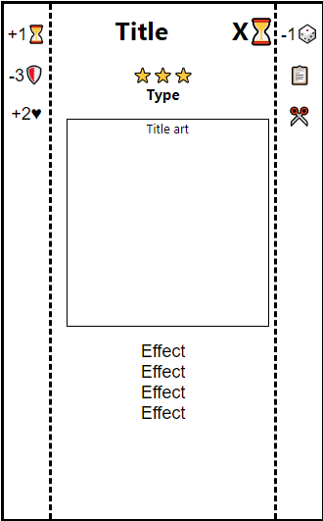
Roadmap for Future Development
Art would help distinguish cards and add flavor
I made a rudimentary script to reuse card templates but work needs to be done to make it look more appealing
Future playtests at higher levels are needed to test balancing

Slide 5
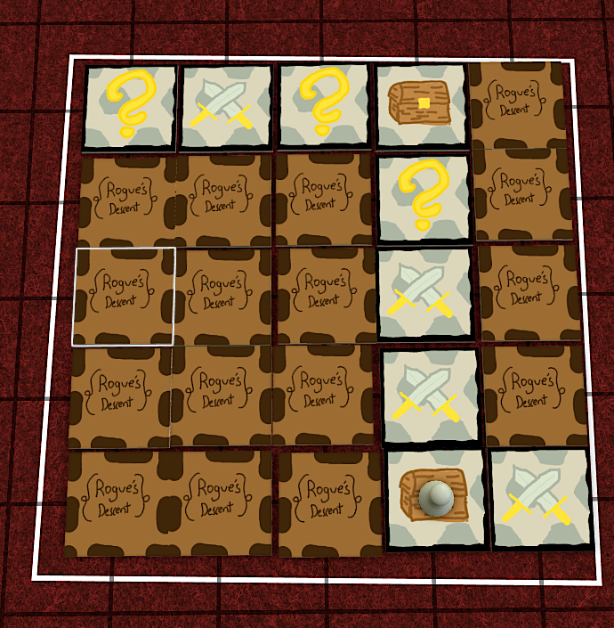
Board Design and Victory Conditions
There are 3 levels. The board is generated by placing tiles in a size based on the level
Level 1: 3x3, 4 Monsters, 2 Items, 3 Events
Level 2: 4x4, 7 Monsters, 4 Items, 5 Events
Level 3: 5x5, 12 Monsters, 5 Items, 8 Events
The player starts on a corner tile and moves to the next level by reaching the opposite corner. Clearing level 3 is the goal.

Slide 6
Mechanics
Players have a set number of Actions they can take before their turn ends and the enemies act.
Move to adjacent tile
Play an action card
Activate an effect
Players draw a card from their deck at the start their turn.

Slide 7
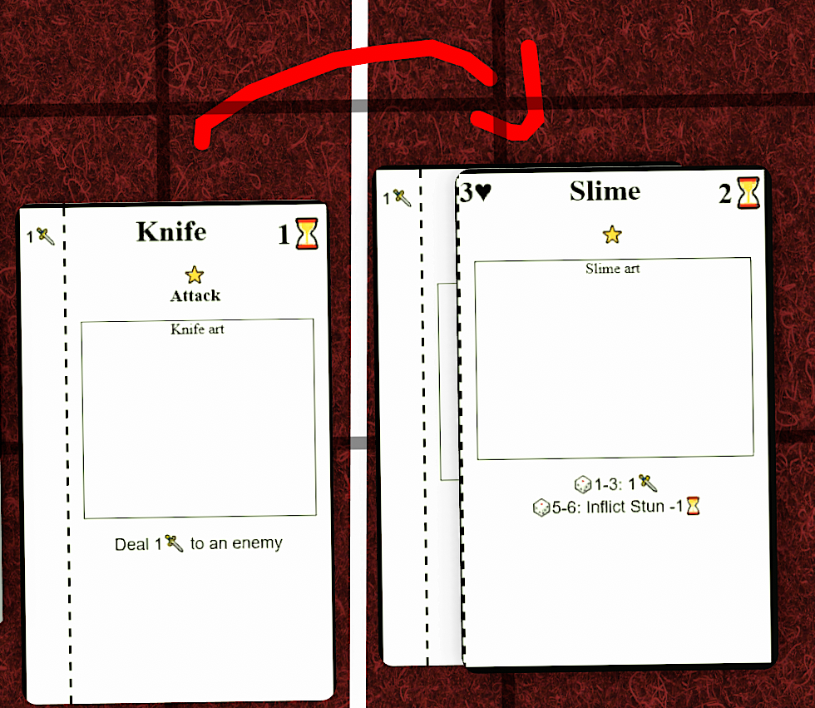
Mechanics - Combat
Damage and effects on enemies is represented by cards.
Enemies take actions after the player based on a dice roll

Slide 8
*Core* Dynamics & Dynamics
Core Dynamics
Collection – Build and fine tune a deck of actions to take out enemies
Turn based gameplay – Players plan around the information revealed to them and strategize to minimize the risk of damage
Dynamics
Exploration – The board is unknown and exploring the board is the only way to gain new cards
Risk analysis – Most tiles have items but a majority of tiles have enemy encounters.

Slide 9
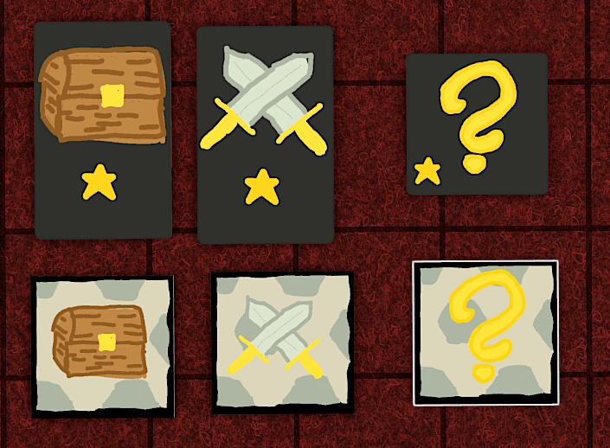
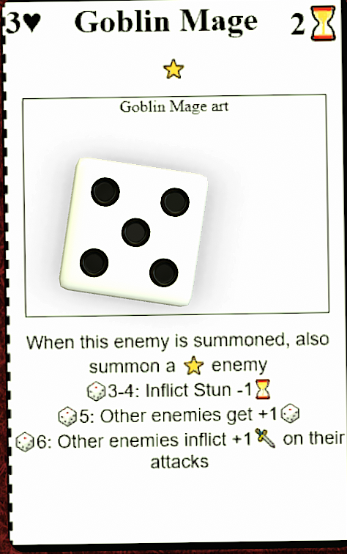
Elements of Chance
Board Generation – Tiles are laid out randomly and specific encounters are decided from decks of cards.
Player’s Deck – The player is building a deck of action cards that is drawn from.
Combat – Enemies take actions by rolling a 6-sided dice

Slide 10
Elements of Skill
Action point management – Players must strategize what actions to take in what order when taking out enemies.
Card management – Cards played on one enemy might take a while before getting to be replayed.
Positioning – Room events require you to stand on the tile, certain actions depend on the explored board state

Slide 11
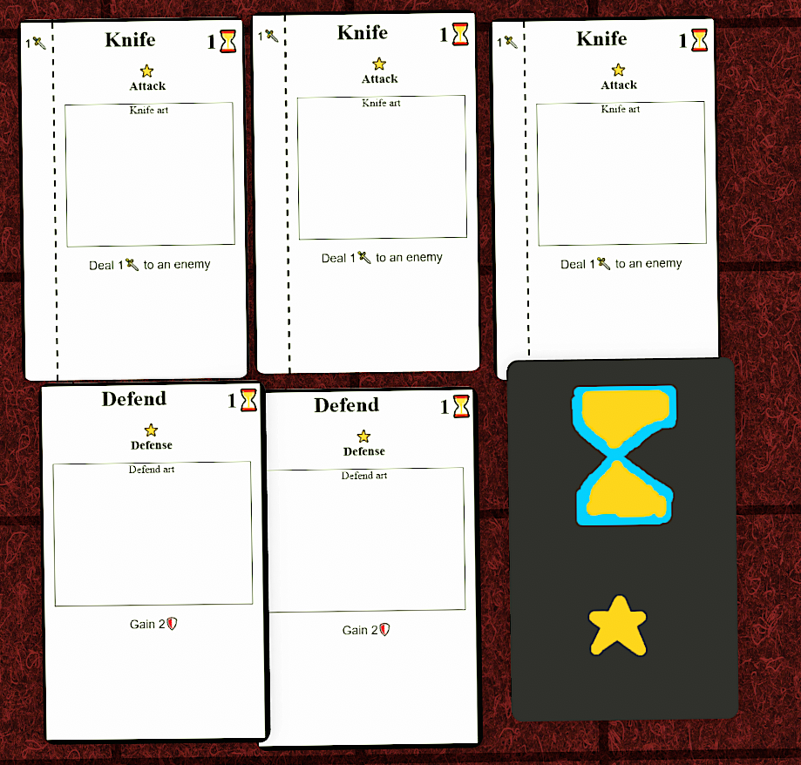
Basic Instructions for Playing
Start at level 1
Shuffle the tiles in a bag and lay them out face down
Deck starts with 3 Knife cards, 2 Defend cards, and 1 Random level one action. Player draws 3 cards at the start of their first turn.
Player starts with 6 health, 3 Action Time per turn and draws 1 card at the start of their turn.
Start the player on a corner and reveal that tile

Slide 12
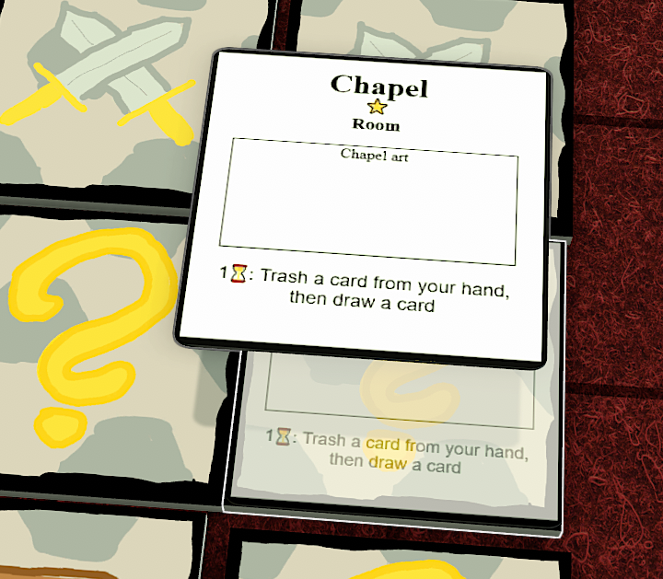
Actions - Board
Moving –1 Action Time to move orthogonally
Reveal tiles you step on
Combat – Summon a enemy
Item – Gain an item
Items are always active once drawn
Event – One time action or a Room that stays on that tile
The ability of rooms only applies if the player is standing in them.
When you reveal the end tile in the opposite corner, you can end the current level at any time.

Slide 13
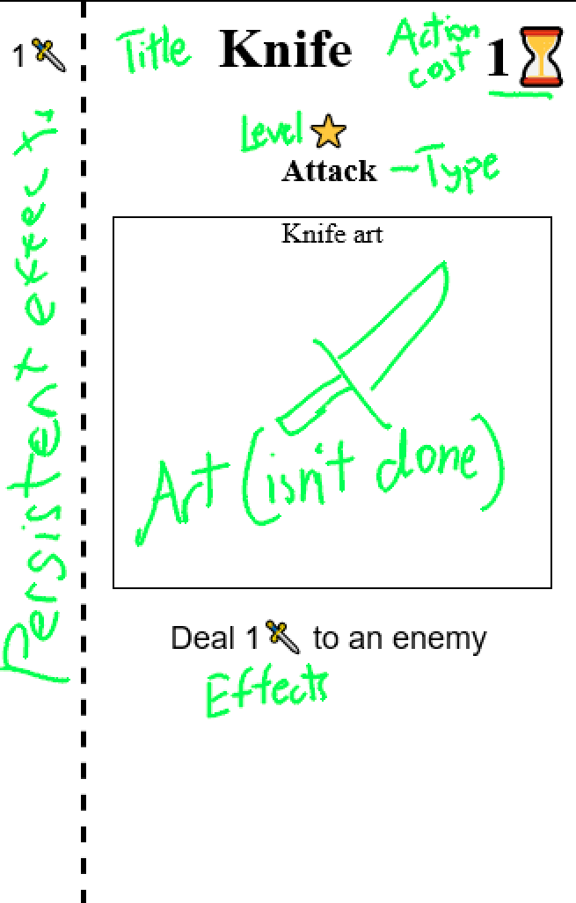
Actions - Combat
Action from hand can be played.
🗡- Damage
⏳-Action time
🛡-Block
Block goes away at the start of turn if there is no attack to the left.

Slide 14
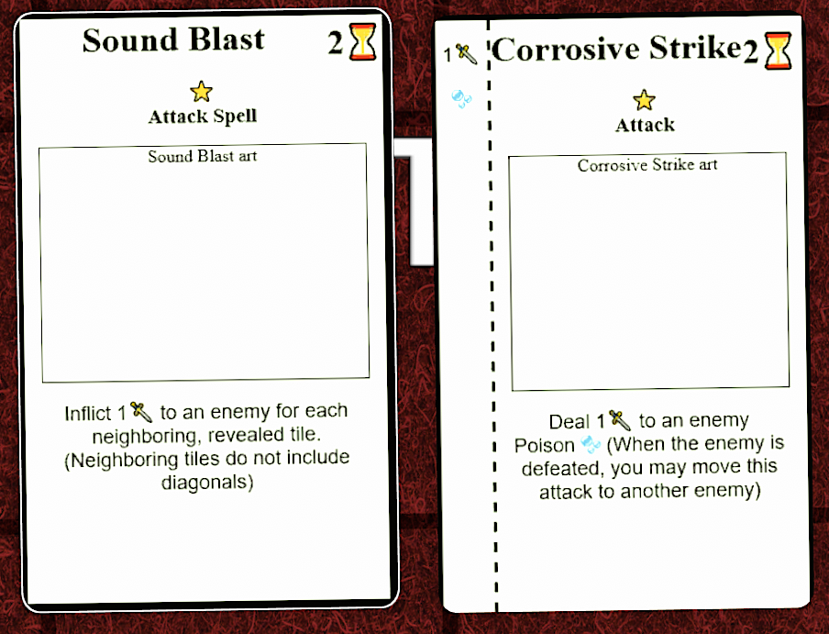
Combat
If a card doesn’t have persistent effects, it gets discarded
When you try to draw from an empty deck, shuffle the discard and continue.
If the discard is also empty, you lose
You can continue exploring the board, but enemies will still take their turns against you.
No persistent effect vs persistent effect

Slide 15
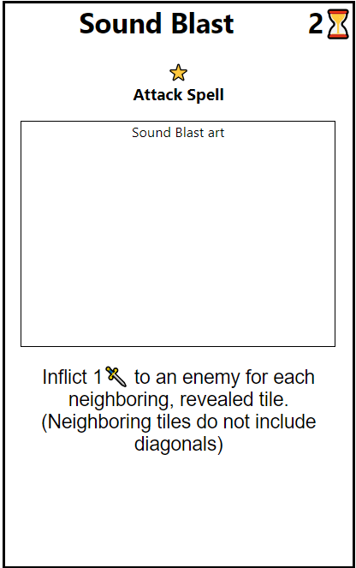
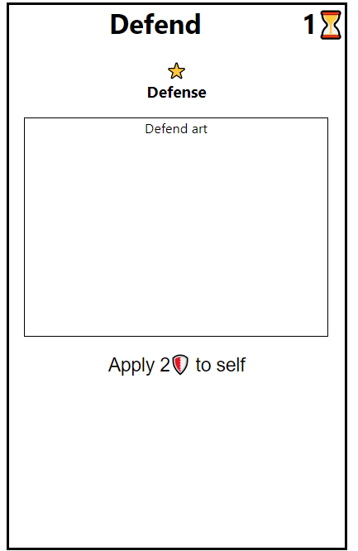
Combat
When you run out of action time and end your turn, enemies act in the order they were summoned
For each action time the enemy has, roll a 6 sided dice and perform the corresponding effect for the enemy
Two keywords are important for timing
An effect that is “inflicted” onto an entity lasts until that entity dies
An entity that “applies” an effect lasts until the start of that entity’s turn

Slide 16
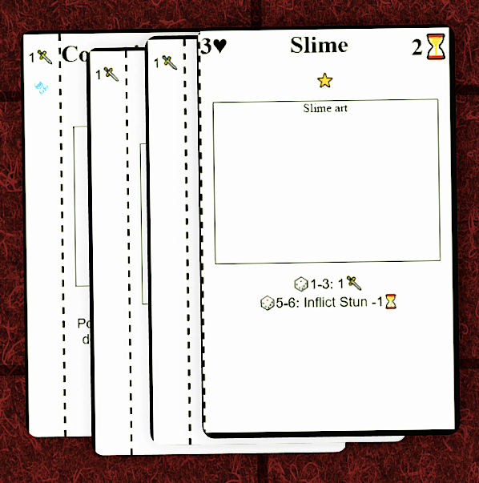
Combat
When damage meets or exceeds health, the enemy dies
All persistent effects go to discard
Look at top 2 card of the action deck for the level
1 goes to discard, 1 goes to trash

Slide 17
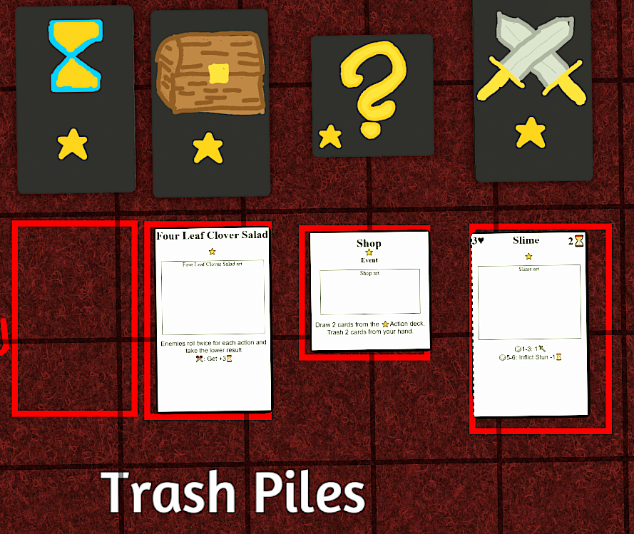
Miscellaneous effects
Each levelled deck has a trash pile. If you need to draw from an emptied levelled deck, shuffle the corresponding trash pile and that becomes the deck.
Activated effects are written as “{cost}:{effect}”
A cost of ✂means to trash the card.

